Slide 1
Predicting stroke
According to research done by the World Health Organization (WHO) stroke is the 2nd leading cause of death globally, responsible for approximately 11% of total deaths in the United States.
This dataset was used to predict someone is likely to get stroke based on the input parameters like gender, age, various diseases, and smoking status etc. Each row in the data provides current information about past patients.
This data set contains 11 features that will our model in predicting stroke related events
Sources
https://www.kaggle.com/fedesoriano

Slide 2
Goals
Some of our goals for this model were to prep the data for model.
Ask questions to see if we can find relevant correlations in the data.
We would then model the data with 3 different top performing models.
Then evaluate the model using relevant metrics for the business.
Finally present the model we think would perform best based on business requirements.

Slide 3
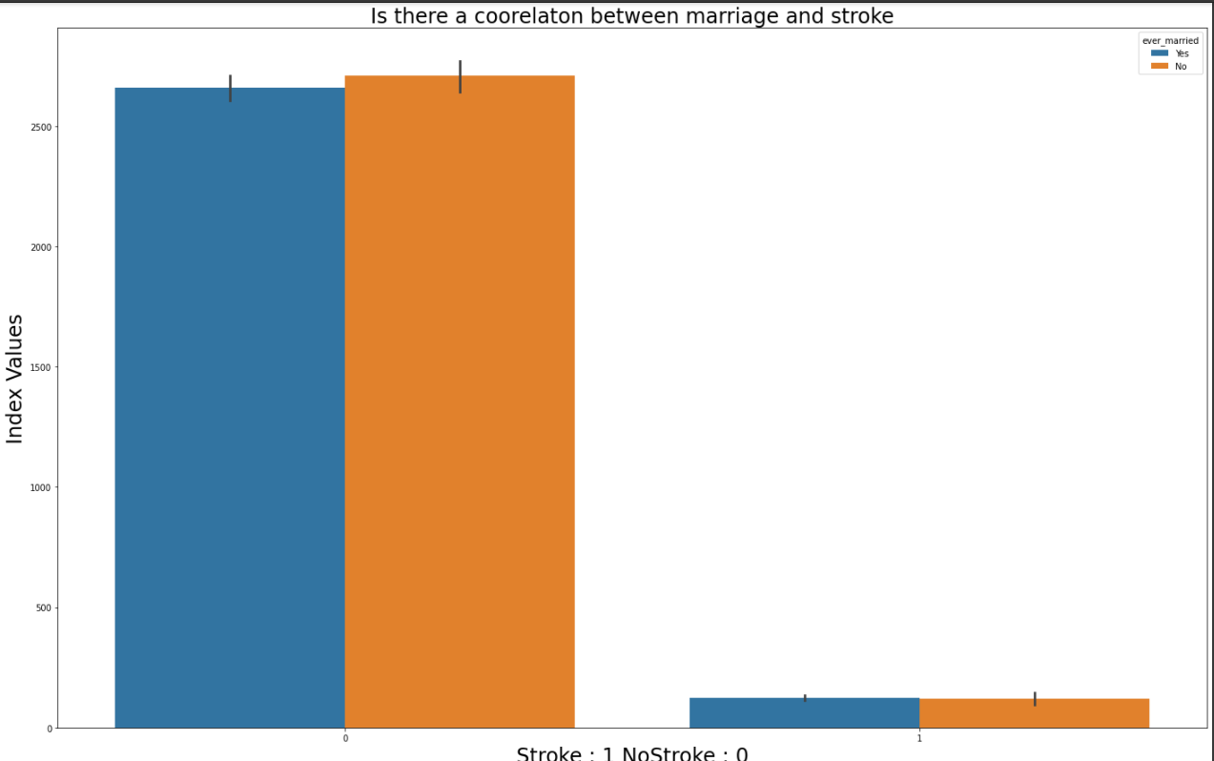
Questions asked

Slide 4
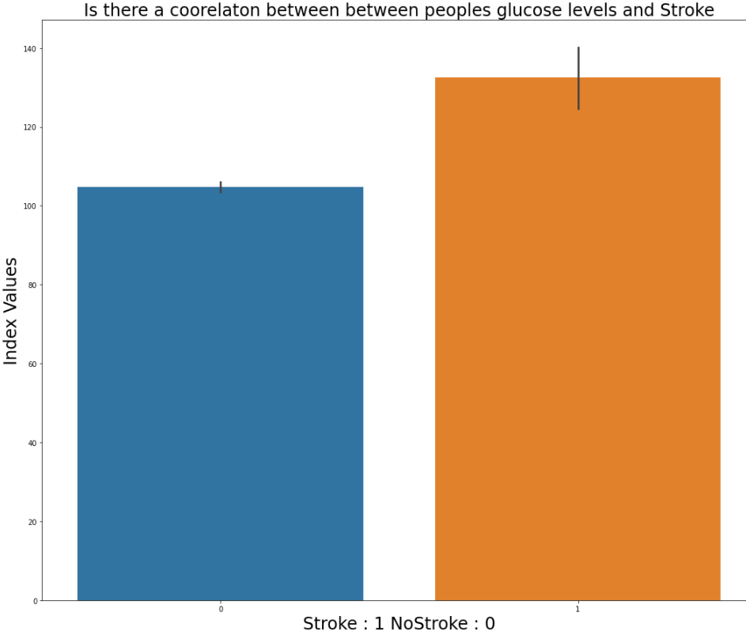
Glucose Levels

Slide 5
The Super Model
The Model that Showed the most promise is called K Nearest Neighbors.
Out of the three Models ran, this one slightly out performed the rest of them, and the results of this model was the best fit the business requirements.
This were three evaluations ran on the models , they check for accuracy , and errors like false negatives and false positives.
Those metrics helped us decided if the model was a best fit for the bussiness , these metrics are important because they may be the deciding factor in saving someone's life.

Slide 6
Final Recommendations
I Believe that this model should not yet be put into production, because there may still be room for improvements .
We also need to acquire more data on people who do have stroke because the data receive was very imbalance by 4000 to 240.
Finally we also will take another of trying to balance the data using code and then retraining to see if we can improve the margin of error on the model.

